Slide 1
Basics of Visual studio & writing Code in C#
- By Nimesh Kumar Dagur, CDAC, India

Slide 2
Topics
A basic working knowledge of visual studio
Write a simple console application
Write a simple desktop application

Slide 3
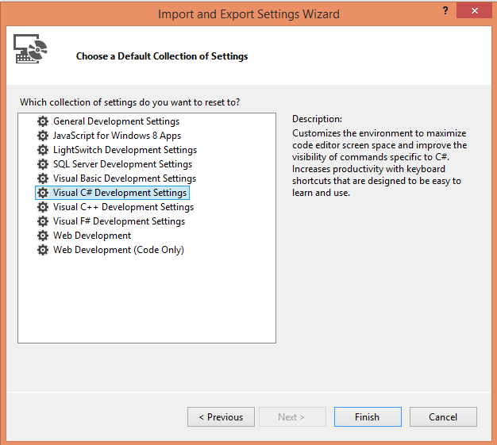
The Visual Studio Integrated Development Environment(IDE)

Slide 4
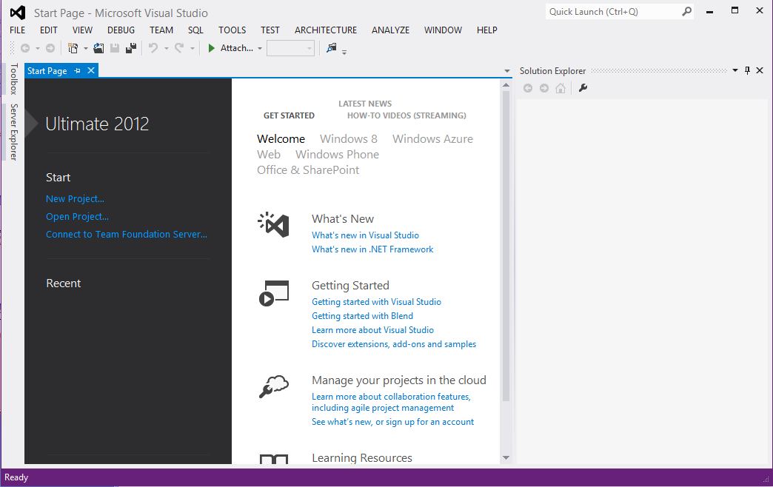
The Visual Studio Development Environment

Slide 5
The Visual Studio Development Environment
The main window, which contains a helpful Start Page by default when VS is started, is where all your code is displayed.
This window can contain many documents, each indicated by a tab, so you can easily switch between several files by clicking their filenames.
Above the main window are toolbars and the VS menu.
Several different toolbars can be placed here, with functionality ranging from saving and loading files to building and running projects to debugging controls.

Slide 6
The Visual Studio Development Environment
The Main window also has functions:
Display GUIs that you are designing for your projects,
Plain-text files, HTML, and various tools that are built into VS

Slide 7
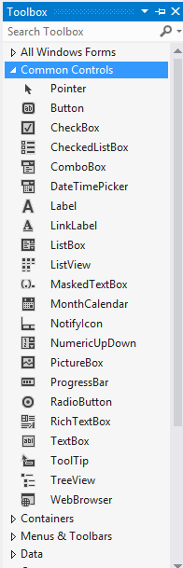
Toolbox window
The Toolbox window pops up when you click its tab. It provides access to, among other things, the
user interface building blocks for desktop applications

Slide 8
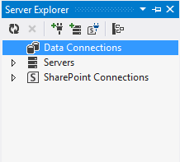
Server Explorer
Server Explorer, can appear via the View ➪ Server Explorer menu option
It includes various additional capabilities, such as providing access to data-sources, server settings, services, and more.

Slide 9
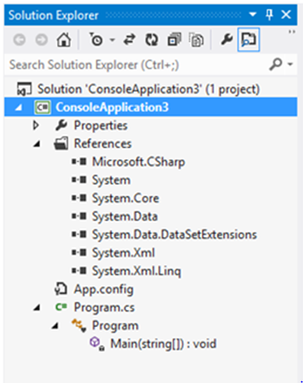
The Solution Explorer

Slide 10
The Solution Explorer
The Solution Explorer window displays information about the currently loaded solution.
A solution is VS terminology for one or more projects along with their configurations.
The Solution Explorer window displays various views of the projects in a solution, such as what files they contain and what is contained in those files.

Slide 11
The Solution Explorer
By default, the Solution Explorer window is docked in the top-right corner of the screen.
As with other windows, you can move it wherever you like, or you can set it to auto-hide by clicking the pin icon.
The Solution Explorer window shares space with another useful window called Class View, which you can display using View ➪ Class View.

Slide 12
The Solution Explorer
In the figure, Solution Explorer view shows the files that make up the ConsoleApplication3 project.
The file to which you added code, Program.cs, is shown along with another code file, AssemblyInfo.cs, and several references.
The References entry contains a list of the .NET libraries you are using in your project.
Class View presents an alternative view of your project by showing the structure of the code you created.

Slide 13
The Solution Explorer
You can use this window to change what code is displayed in the main window by double-clicking .cs files or right-clicking them and selecting View Code or by selecting them and clicking the toolbar button that appears at the top of the window.
You can also perform other operations on files here, such as renaming them or deleting them from your project.
Other file types can also appear here, such as project resources (resources are files used by the project that might not be C# files, such as bitmap images and sound files).
Again, you can manipulate them through the same interface.

Slide 14
The Properties Window
This window provides a more detailed view of the project’s contents, enabling you to perform additional configuration of individual elements.
For example, you can use this window to change the appearance of a button in a desktop application.

Slide 15
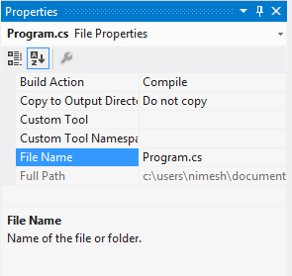
The Properties Window
The Properties window (select View ➪ Properties Window if it isn’t already displayed) shows additional information about whatever you select in the window above it.
For example, the view shown in Figure is displayed when the Program.cs file from the project is selected.
This window also displays information about other selected items, such as user interface components

Slide 16

The Error List Window
Error List window can display using View ➪ Error List.
It shows errors, warnings, and other project-related information.
The window updates continuously, although some information appears only when a project is compiled.

Slide 17
The Error List Window
This window helps you eradicate bugs in your code because it keeps track of what you have to do to compile projects.
If you double-click the error shown here, the cursor jumps to the position of the error in your source code ,so you can fix it quickly.
Red wavy lines appear at the positions of errors in the code, so you can quickly scan the source code to see where problems lie.

Slide 18
The Error List Window
The error location is specified as a line number.
By default, line numbers aren’t displayed in the VS text editor, but that is something well worth turning on.
To do so, tick the Line numbers check box in the Options dialog box (selected via the Tools ➪ Options menu item).
It appears in the Text Editor ➪ All Languages ➪ General category
You can also change this setting on a per-language basis through the language-specific settings pages in the dialog box.

Slide 19
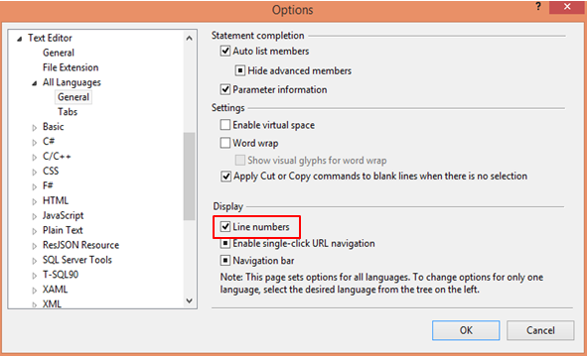
The Error List Window

Slide 20
VS is capable of displaying many other windows, both informational and functional.
Many of these can share screen space with the windows mentioned here, and you can switch between them using tabs, dock them elsewhere, or even detach them and place them on other displays if you have multiple monitors.

Slide 21
Developing Applications in VS
VS 2012 provides various project templates to allow you to develop different types of .NET applications.
These project templates offer an easy and convenient way of developing .NET applications as they, by default ,include the essential files and assemblies required for an application.
Types of applications in VS :
Console applications
Windows forms applications
Web Applications

Slide 22


Slide 23
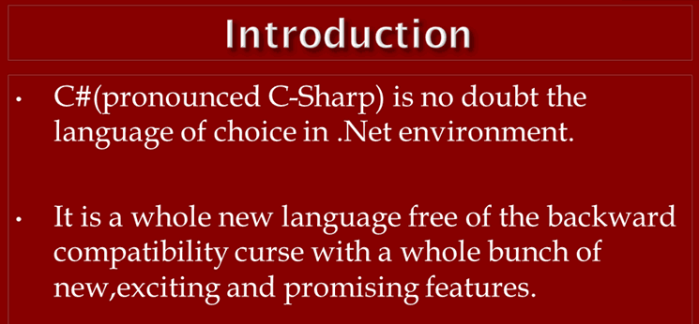

Slide 24
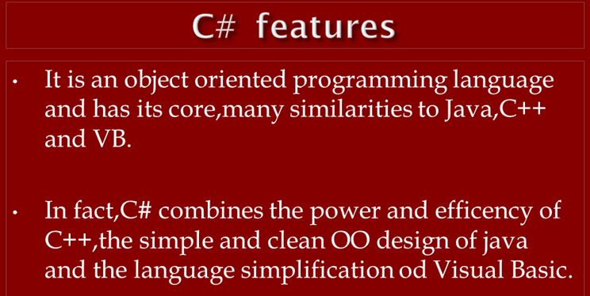


Slide 25
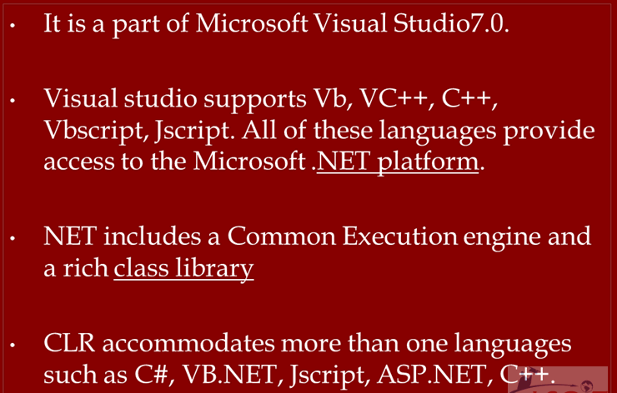

Slide 26
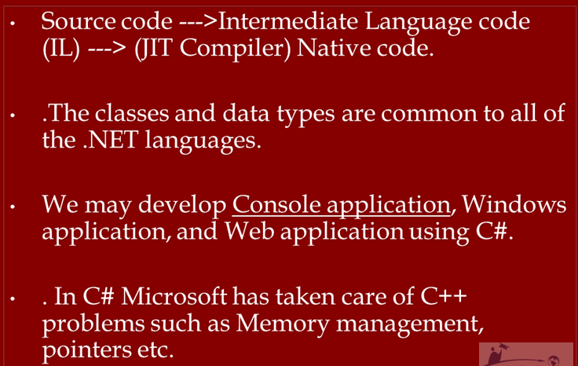

Slide 27
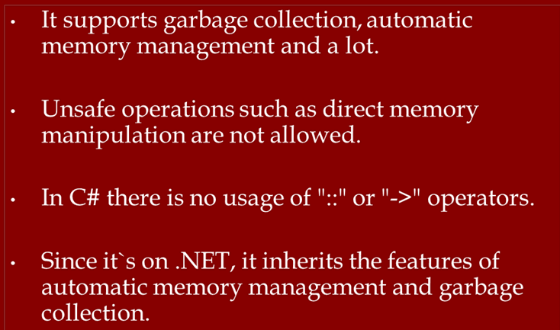

Slide 28


Slide 29
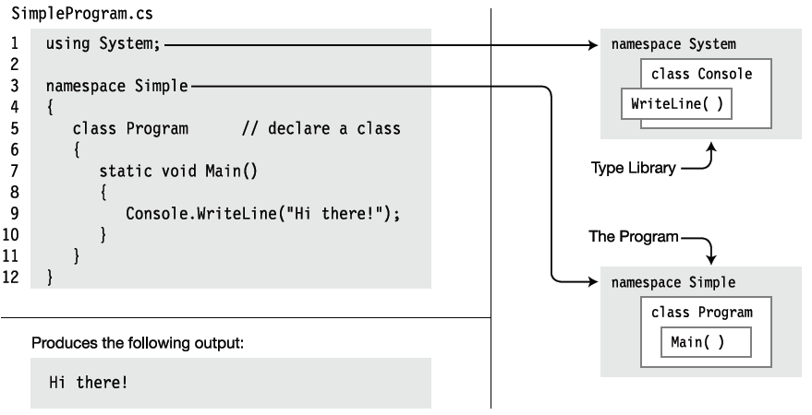
Developing a Console Application

Slide 30
First C# Program
Using Notepad

Slide 31
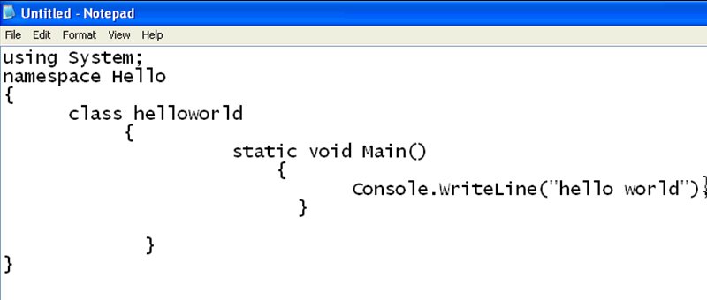
Open notepad and write the following program
Save this program with .cs extension

Slide 32
We can save this file by any name and in any drive or folder
I saved this file in D drive as : hello.cs

Slide 33
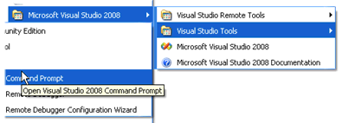
It will open command prompt
Now “ Hello.cs ” is a source file of C#
We have to compile it from command prompt
So open the visual studio command prompt

Slide 34
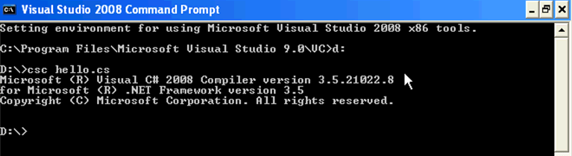
csc is the C # compiler and it will generate MSIL and some metadata for CLR
Now go to D drive and compile the program using C Sharp compiler as below

Slide 35

How to run the program from the command prompt : it will generate hello.exe

Slide 36
The same program with Visual Studio
You will feel it is easy to work with Visual Studio

Slide 37
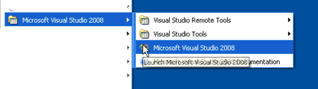
Open the visual studio

Slide 38
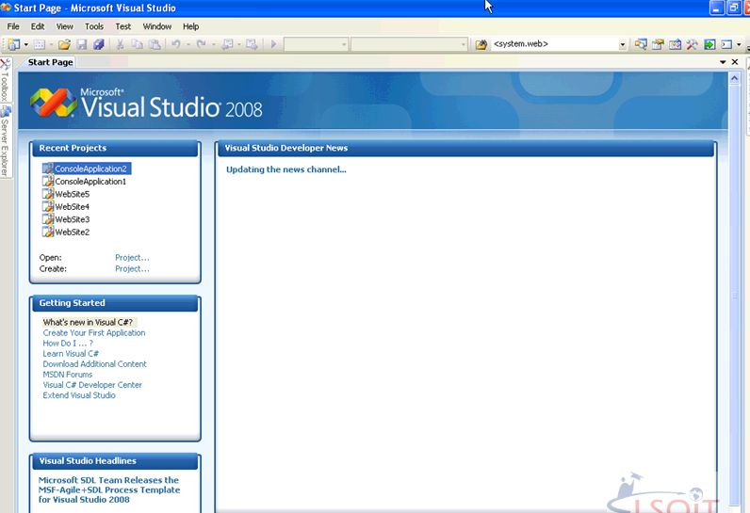
It will open as below

Slide 39
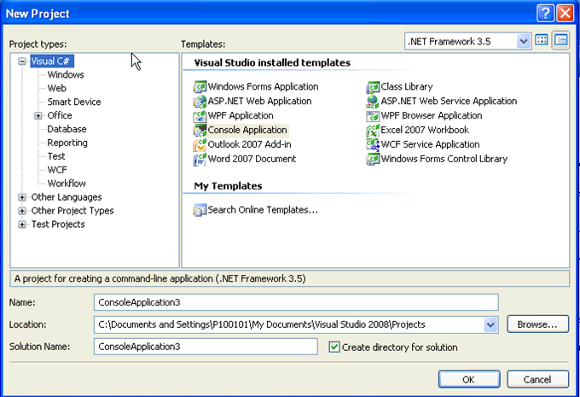
File -----new -----project

Slide 40
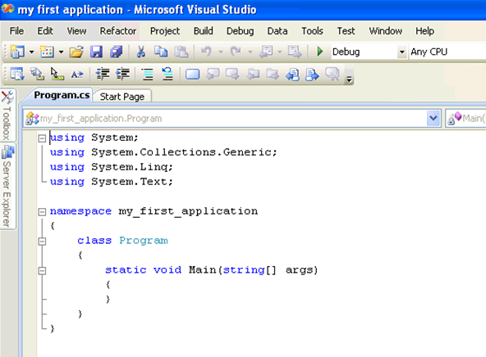

Slide 41
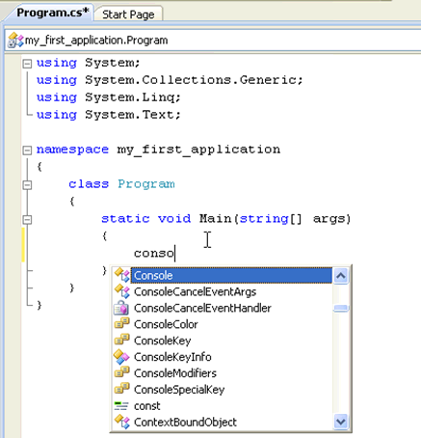

Slide 42
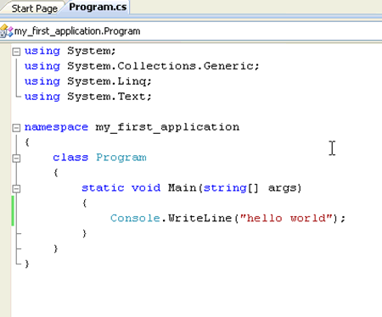

Slide 43
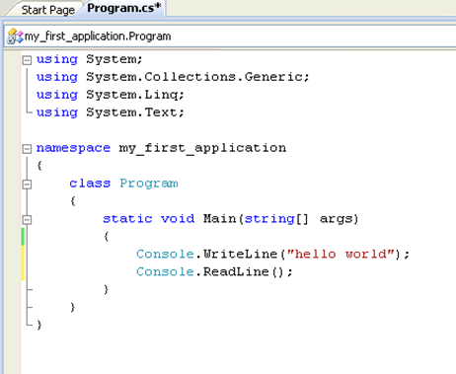

Slide 44


Slide 45
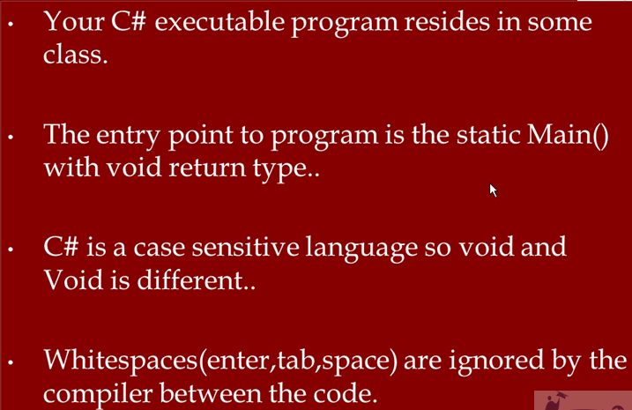

Slide 46
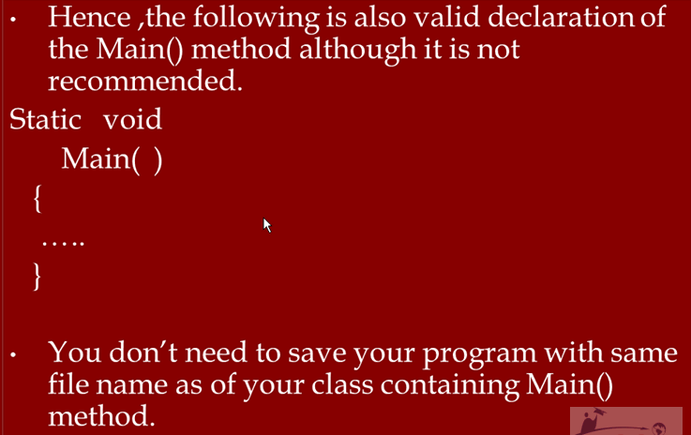

Slide 47
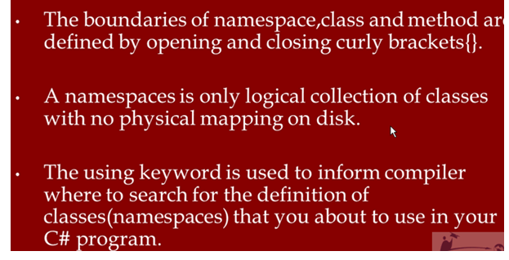

Slide 48


